Slide 1
Investigating the genetic marks left by Neanderthals and Denisovans in the genomes of non-Africans
Cæcilia Lind Skov-Jensen
Notes:
Hi. My Master’s thesis was about investigating the meetings between anatomically modern humans, Neanderthals, and Denisovans, and more specifically looking at the genetic marks that Neanderthals and Denisovans left in the genomes of present-day non-African populations.

Slide 2

Background
For over 150 years we have known about Neanderthals and have been interested in who they were, how they lived, and most importantly how our ancestors interacted with them
In 2010 the first Neanderthal genome was sequenced making it possible to compare with modern day genomes and find Neanderthal content
It was then discovered that all present-day non-African populations have around 2% Neanderthal DNA in their genomes, which is explained by an admixture event between anatomically modern humans and Neanderthals before the split of populations
Later in 2010 another archaic genome was sequenced, called Denisovans. The proportion of Denisovan DNA in present-day humans is highly variable
Populations in Oceania have 3-6% depending on Papuan ancestry
Populations in mainland Eurasia and America have less than 1%
However, there is still uncertainty about the extent of the meetings between the species, how many admixture events happened and where they took place
Slide 1 of 12 Cæcilia Lind Skov-Jensen
Notes:
Neanderthals were first defined over 150 years ago and it has been an ongoing interest to find out more about them like who they were, how they lived, and particularly how our ancestors interacted with them. Through findings of remains throughout the years, it has been made possible to obtain a great knowledge about what they looked like and how they lived.
But first in 2010, the first Neanderthal genome was sequenced which made it possible to compare to modern day genomes and locate Neanderthal content. This led to the discovery that all present-day non-African populations have about 2% introgressed Neanderthal DNA in their genomes, indicating that the anatomically modern humans, our ancestors, met and interbred with Neanderthals at one location before splitting to the rest of the world.
Later in 2010, another hominin species was sequenced, called the Denisovans. The proportion of Denisovan DNA in present-day humans is however highly variable in contrast to Neanderthals.
The highest proportion of 3-6% is found in Oceania based on Papuan ancestry, while populations in mainland Eurasia and America have less than 1% introgressed Denisova DNA.
But even though we now know more about the genetic marks left by Neanderthals and Denisovans in humans today, the extent of the meetings with these species remain unclear.

Slide 3
Purpose
Compare archaic content among present-day human populations in order to compare the genomes of the introgressing populations more specifically
Calculate the nucleotide divergence between all pairs of non-African populations
Compare the divergence patterns in the archaic content with the divergence in the whole genome
Compare the amount of overlap of archaic content between populations
Find out whether archaic components that in previous studies are thought to be the same, are stemming from the same population source or even the same event
Slide 2 of 12 Cæcilia Lind Skov-Jensen
Notes:
The purpose of this thesis was therefore to compare the archaic content among present-day human populations in order to compare the genomes of the introgressing populations more specifically.
This was done by calculating the nucleotide divergence between all pairs of non-African populations and then compare the divergence patterns in the archaic content with the divergence patterns in the whole genome, as well as comparing the amount of overlapping archaic sequence between the populations.
In this way I would be able to find out whether archaic components are stemming from the same population source or from the same event.

Slide 4
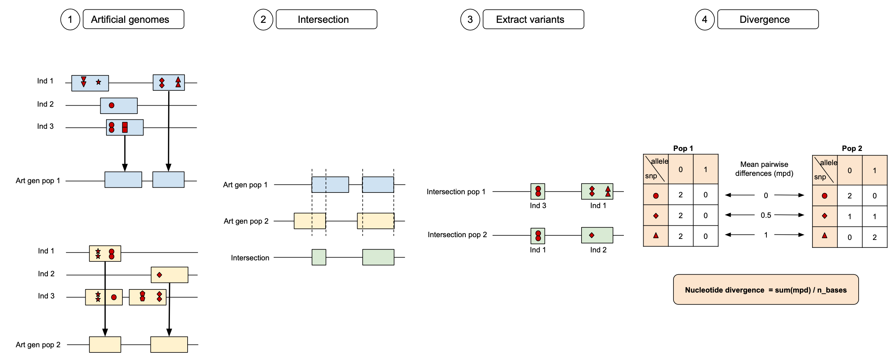
Methods
Slide 3 of 12 Cæcilia Lind Skov-Jensen
Notes:
The first step was to create so-called artificial genomes for Neanderthals and Denisovans. This was done by sampling individuals from each population and their archaic fragments. Artificial genomes were made for each population by randomly sampling non-overlapping fragments. Each archaic fragment contains variation shown by the different red shapes that will be used later.
When archaic artificial genomes were created for all populations, the overlapping intervals were found between each pair of populations.
The archaic fragments and individuals that contributed to the intersection are then found for each population, and the variants in this specific fragment are identified. These are then used to find the genotypes at each variant position in the fragment. Variants with two red shapes represent homozygosity for the derived allele (allele 0), one shape represents heterozygosity, and no shapes represent homozygosity for the ancestral allele (allele 1).
The genotypes are then compared for each population, and the mean pairwise differences (mpd) are calculated. The nucleotide divergence between the two populations is then calculated by summing the mpd and dividing by the total number of bases (intersection length).

Slide 5
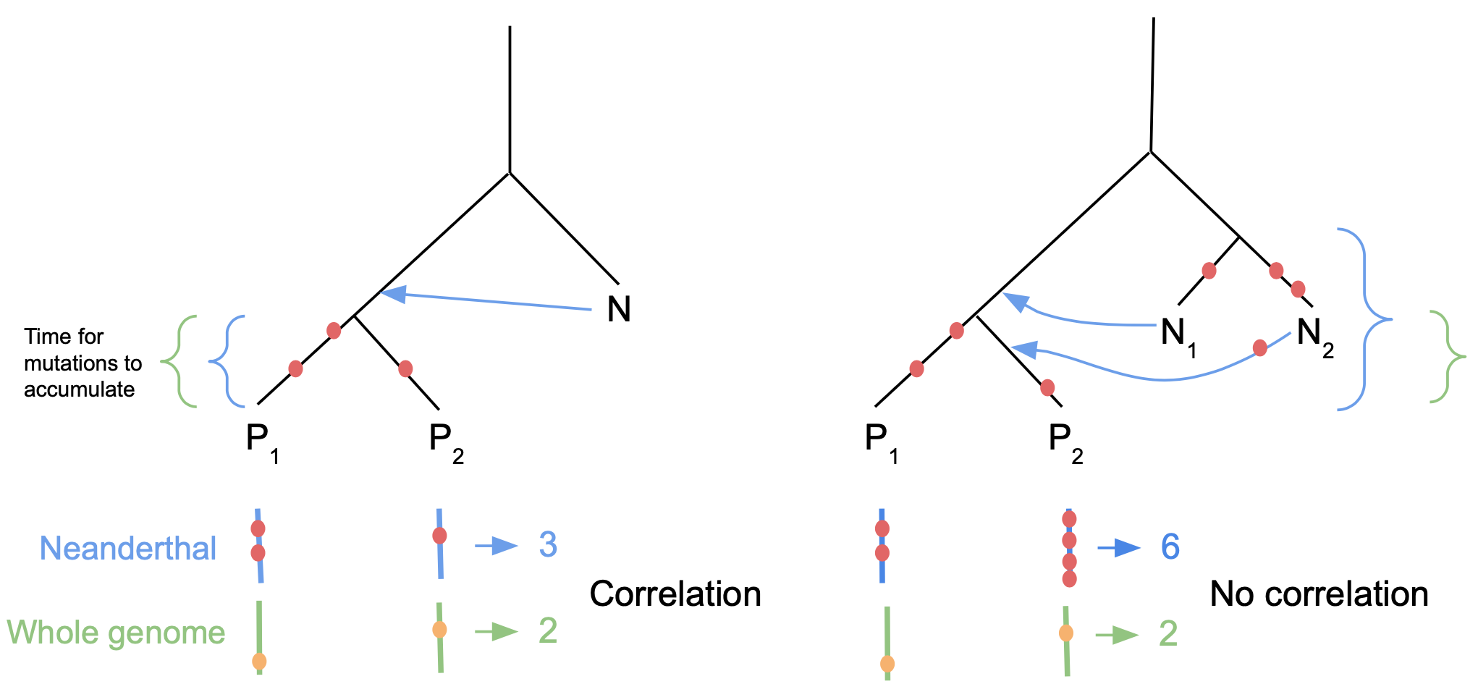
Nucleotide divergence
Divergence is a measure of the mutations that accumulated since the most recent common ancestor
One source population
All mutations in archaic fragments would happen after the split
Correlation with “human” part because of same time for mutations to accumulate
Multiple source populations
More mutations in archaic fragments because more time for them to accumulate than in “human” part
No correlation between archaic than “human”
Slide 4 of 12 Cæcilia Lind Skov-Jensen
Notes:
The nucleotide divergence is a measure of the mutations that have accumulated over time in the populations, and in that way, it can be used to determine whether the introgressing population source was the same for two populations.
Let us say that we have a case where we have a tree that looks like this to the left with a single Neanderthal population source (N) and two populations (P1 and P2). Let us then say that there was an admixture event before the split of the two populations, which means that all the Neanderthal content in population 1 and population 2 is the same. When divergence is measured it is basically how many mutations they accumulated since the most recent common ancestor. Let us say that the red dots are mutations. So, there would have been three mutations, which means the divergence measure would end up around three. If we look at a human haplotype, we will get something similar assuming the same mutation rate because the time for mutations to accumulate is the same. Let us say we observe two mutations. So, a divergence of three and two is quite similar, meaning they correlate, and that all mutations that happened in the Neanderthal fragments happened since the split.
If we look at another case where there were two admixture events with Neanderthals. So, when I compare population 1 with population 2, I am comparing a Neanderthal fragment that came from N1 and a Neanderthal fragment that came from N2. There would have been more time for mutations to accumulate to make the fragments more different. This results in more mutations for Neanderthal fragments in contrast to when looking at the whole genome, where there hasn’t been as long time. Because when you compare the whole genome, it would only be the time to the most recent common ancestor.
This means that for the first tree because they had the same time to accumulate mutations, and the number of mutations correlate, they must come from the same source population.
For the other tree, because the Neanderthal fragments had more time to accumulate mutations than what we see for the whole genome part, and the Neanderthal divergence is much higher than the whole genome divergence, it will mean that the source populations might be different.

Slide 6
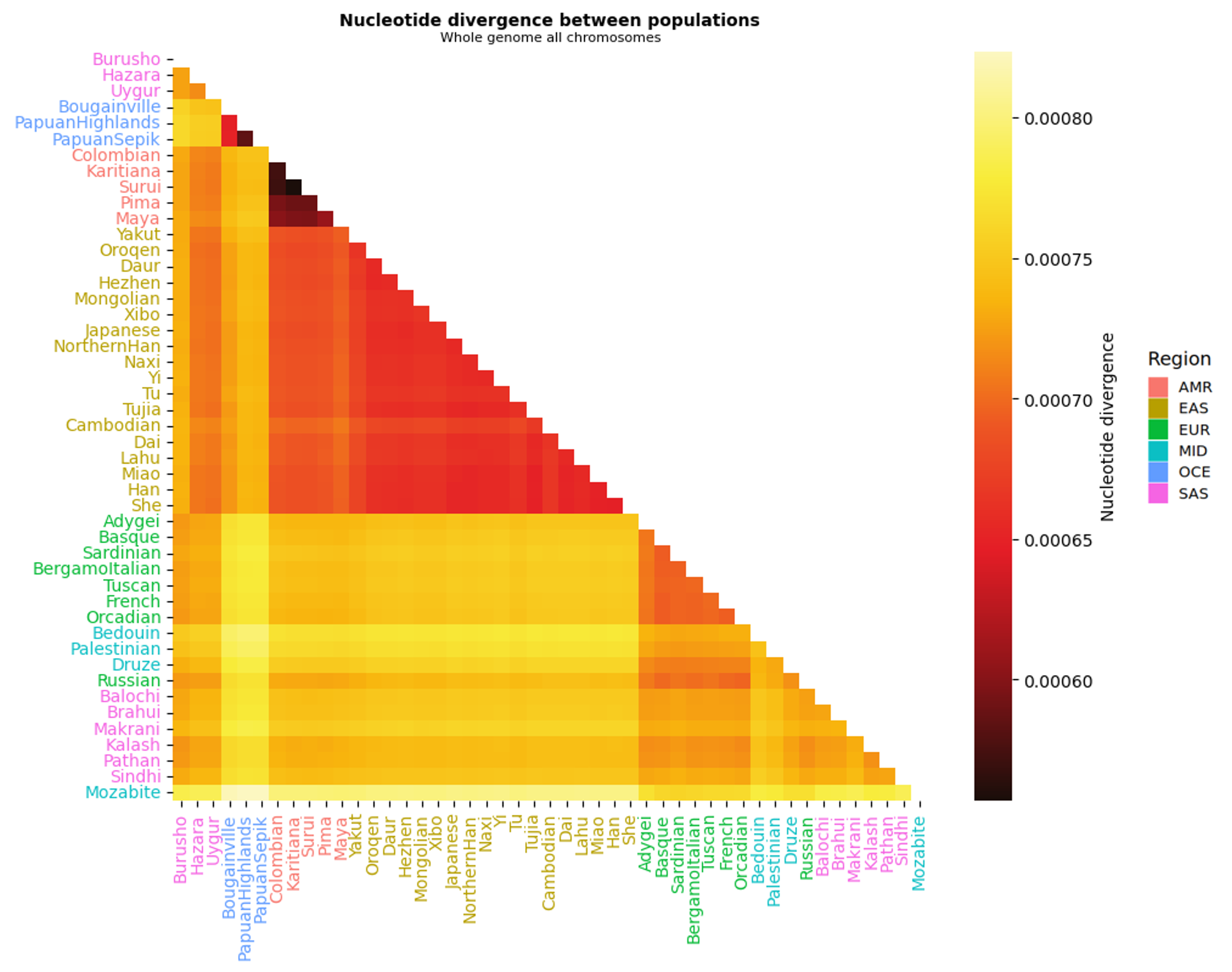
Whole genome divergence pattern
Clear clusters that separate the regions
Lowest divergence is observed within America, and within Oceania
Highest divergence is observed between Oceania and Europe/Middle East/South Asia
Slide 5 of 12 Cæcilia Lind Skov-Jensen
Notes:
Taking a quick overview of the divergence pattern for the whole genome, we see that there are some clear cluster division of regions. The lowest divergence is found within America and within Oceania, while the highest divergence is found between Oceania and Europe, Middle East, and South Asia.

Slide 7
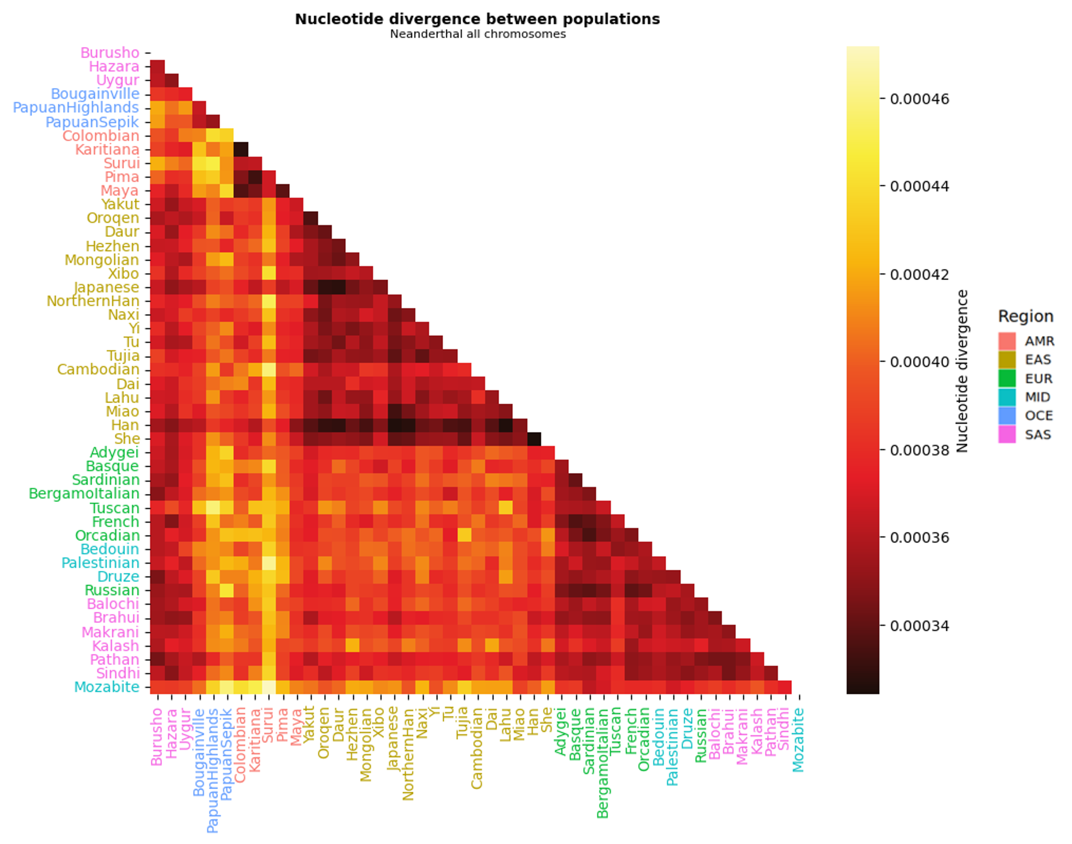
Neanderthal divergence pattern
The divergence range is so much smaller
Highest value is 0.00046, whereas smallest value for whole genome divergence is 0.00060
Still division in clusters but less clear
High divergence between Oceania and the rest of the regions, as well as between America and the rest of the regions
Slide 6 of 12 Cæcilia Lind Skov-Jensen
Notes:
If we look at the Neanderthal divergence, the first thing I observed was that the divergence is much lower.
we see the same pattern with the

Slide 8

Denisova divergence pattern
Even more unclear clusters
Much higher divergence than for Neanderthal
More like divergence range for whole genome
High divergence between Oceania and Europe/Middle East, Oceania and America, as well as East Asia and Europe/Middle East
Slide 7 of 12 Cæcilia Lind Skov-Jensen

Slide 9
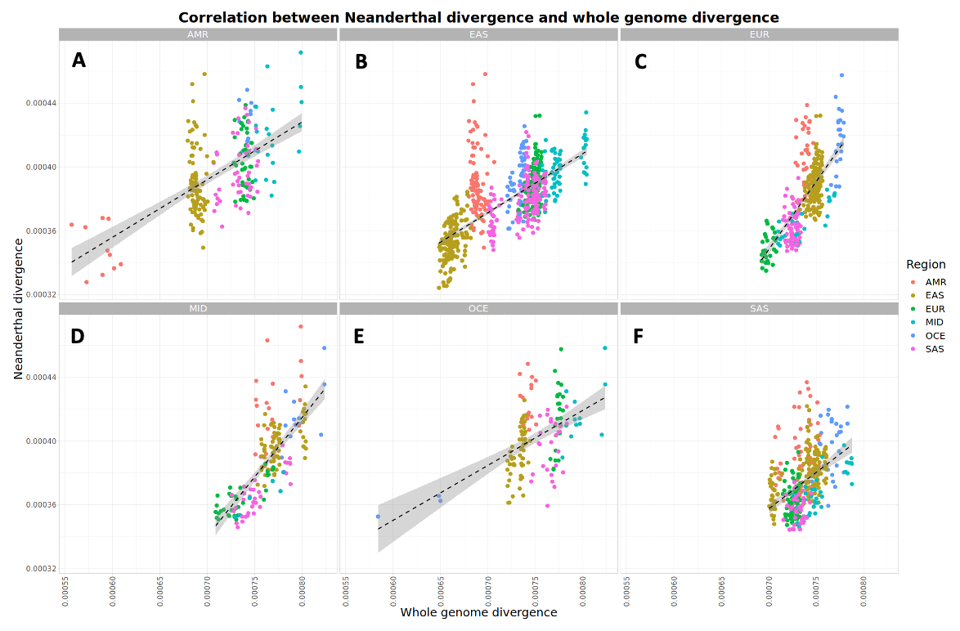
Neanderthal vs. whole genome divergence
Positive correlation between Neanderthal divergence and whole genome divergence
American and Oceanian populations are less divergent within their region than other regions
Geographically isolated regions means limited amount of genetic exchange with other populations
Not as much spread in South Asia
Multiple contributions from different ancestral components
The Neanderthal divergence is low
Suggests a single introgression from a Neanderthal population before the split of non-African populations
Slide 8 of 12 Cæcilia Lind Skov-Jensen
Notes:
Looking at the Neanderthal divergence and the whole genome divergence we see that there overall is a positive correlation.
Specifically, for America and Oceania it is clear that the divergence within the regions is much smaller than other regions. This could be explained by the fact that both these regions are located geographically isolated from the other regions, which has limited the amount of gene flow and genetic exchange with other populations, resulting in a higher divergence between them and the other regions.
From the plots it seems that there generally is a division of the regions, however this does not seem to be the case when comparing South Asia to other regions. Here the populations are more clustered together and it is more difficult to distinguish the different regions. This could indicate that South Asia had multiple contributions from different ancestral components related to the other regions.
Besides that, the Neanderthal divergence is generally really low, indicating that there was only a single introgression event from a Neanderthal population.

Slide 10
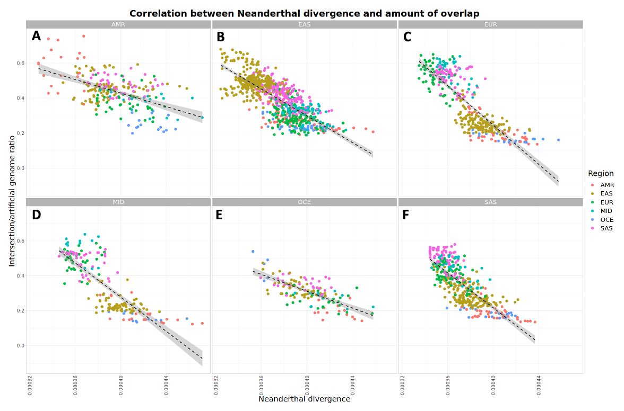
Neanderthal divergence vs. amount of overlap
Negative correlation between Neanderthal divergence and the amount of overlap of Neanderthal segments between the populations
American populations have a significant overlap (~70%) of Neanderthal segments within America
More recent migration means less time for a genetic divergence to accumulate
Genetic bottleneck effect means reduced genetic diversity between populations and increased homogeneity
Geographically isolated means limited amount of gene flow and genetic exchange with other populations
Europe, South Asia and Middle East have the smallest overlap with East Asia, America and Oceania
These plots support the hypothesis of one introgression event from one population source
Slide 9 of 12 Cæcilia Lind Skov-Jensen
Notes:
Looking further into the overlap of Neanderthal segments between populations, we see an overall negative correlation. The most overlap is generally found within a region, however, if we look at the overlap within America, the overlap is significantly bigger than within other regions. This could be explained by multiple things such that we know that the migration to America happened more recently, which means that there has been less time for divergence to accumulate between the populations. Secondly, the migration only included a small founder population, which means that the number of individuals contributing to the gene pool was small, and therefore the homogeneity is increased. At last, America is also located isolated from the rest of the regions, which means that the amount of genetic exchange with other populations has been limited.
Besides that, we see that Europe, South Asia and Middle East have the smallest overlap with America and with Oceania, which indicates that the populations in these regions split from America and Oceania longer ago than from each other.
Overall, these plots support the theory of one introgression event from one Neanderthal population source before the split of populations.

Slide 11
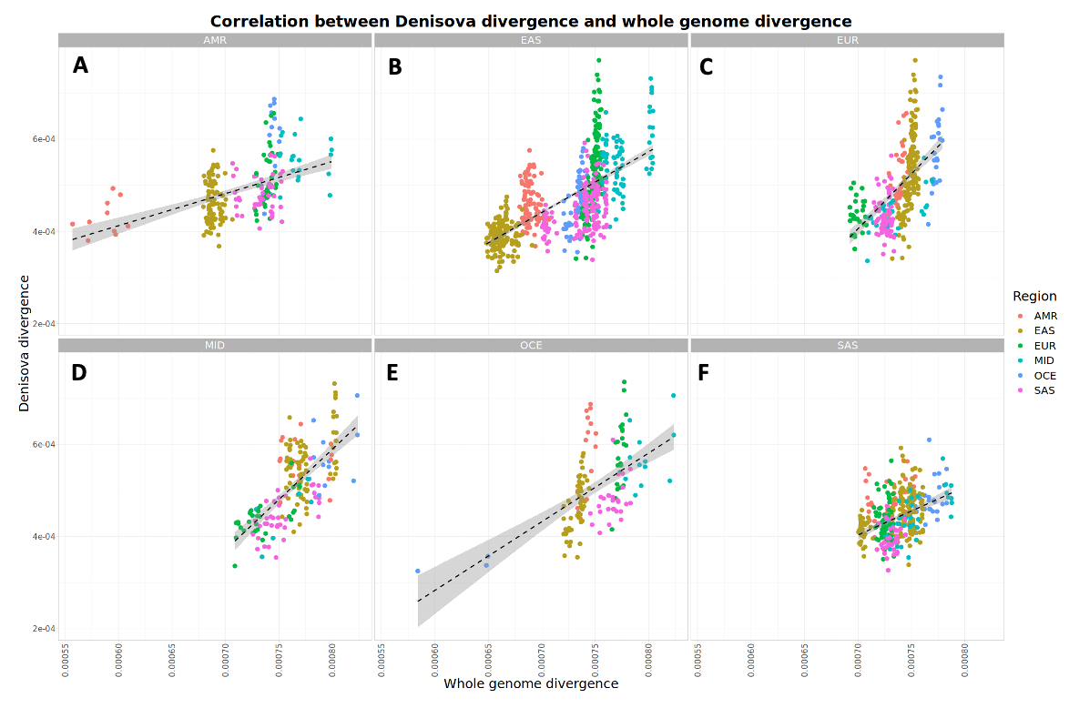
Denisova vs. whole genome divergence
Positive correlation between Denisova divergence and whole genome divergence
The Denisova divergence within Oceania is much smaller than when comparing Oceania to the other regions
Could indicate that Oceania had a different source of Denisova content
Geographically isolated means limited amount of gene flow and genetic exchange with other populations
The genetic diversity within populations in Oceania has evolved independently over time, contributing to the increased divergence from other populations
Even less spread for South Asia
The Denisova divergence is higher than the Neanderthal divergence
Could suggest multiple introgression events from multiple divergent Denisovan population sources
Slide 10 of 12 Cæcilia Lind Skov-Jensen
Notes:
If we look at the Denisova divergence against the divergence for the whole genome, there is also an overall positive correlation.
The most eye-catching is the low Denisova divergence observed within Oceania compared to the other regions. This could indicate that Oceania might have had a different source of Denisova content and therefore the divergence is bigger when compared to other regions. But it could also be because Oceania is located isolated from the rest of the regions and therefore the amount of gene flow and genetic exchange with other populations has been limited and the divergence is therefore bigger from other populations.
Besides that, we see the same thing for South Asia only more condensed, which again suggests that South Asia had multiple contributions from different ancestral components related to the other regions.
Overall, the Denisova divergence is higher than the Neanderthal divergence, indicating that there might have been multiple admixture events involving multiple different Denisovan population sources.

Slide 12
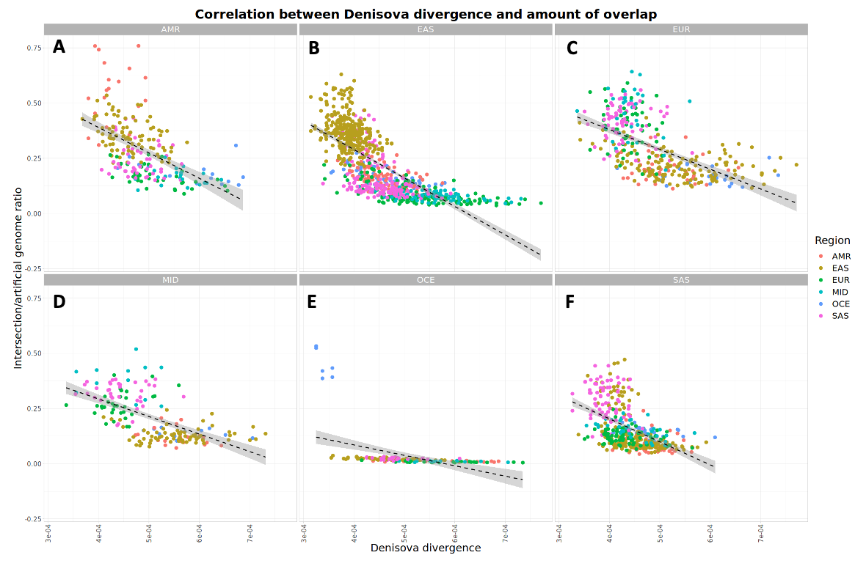
Denisova divergence vs. amount of overlap
Negative correlation between Denisova divergence and the amount of overlap of Denisova segments between the populations
Populations have a generally smaller overlap of Denisova segments compared to the Neanderthal segments
Could reflect that multiple independent introgression events occurred for Denisovans and a single introgression event for Neanderthals
American populations have a significant overlap of Denisovan segments between them
More recent migration means less time for a genetic divergence to accumulate
Genetic bottleneck effect means reduced genetic diversity between populations and increased homogeneity
Geographically isolated means limited amount of gene flow and genetic exchange with other populations
Oceanian populations have little to no overlap of Denisovan segments with other populations
Support the theory of an admixture event unique to the Oceanian populations
Slide 11 of 12 Cæcilia Lind Skov-Jensen
Notes:
Looking further into the overlap of Denisova content between the populations, we see a negative correlation.
Overall, the overlap of Denisovan segments is smaller compared to Neanderthals, which supports the theory that there has been multiple admixture event with different Denisovan sources.
Besides that, we see again that America has a big overlap within the region like we saw for the Neanderthal segments, which again can be a result of the fact that the migration to America happened more recently and there was a genetic bottleneck effect, which has reduced the genetic diversity between the populations in America.
The most eye-catching is however the plot for Oceania. Here we observe that there is little to no overlap between the Denisova segments in Oceania and other regions. This supports the theory that Oceania had an admixture event that was unique to them only.

Slide 13
Concluding remarks
The Neanderthal divergence measurements supported a single introgression event from one Neanderthal population source that happened before the split of non-African populations
The Denisova divergence measurements suggested multiple introgression events from multiple Denisova population sources
Future work could involve other strategies for sampling archaic content, such as
Downsampling to have the same number of individuals in all samples
Sampling the longest non-overlapping fragments to get more information
Including all fragments
Slide 12 of 12 Cæcilia Lind Skov-Jensen
Notes:
So, summarizing the results, the Neanderthal divergence measurements supported an admixture event from a Neanderthal population source that happened before the split of non-African populations.
While the Denisova divergence measurements suggested that multiple introgression events had happened involving multiple Denisova population sources.
I think that for future work it should involve other strategies for sampling the archaic content such as downsampling to have the same number of individuals in all samples to avoid sample bias, sampling the longest non-overlapping fragment in order to avoid losing as much information, sampling all non-overlapping intervals, or simply including all fragments.

